Slide 1
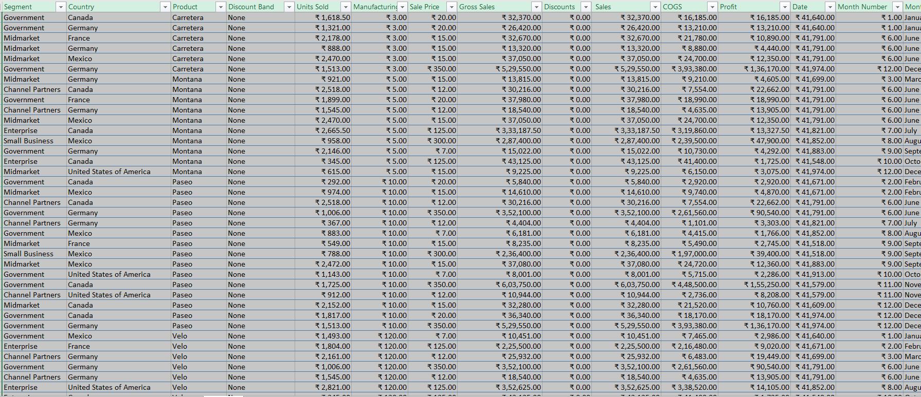
DATA CLEANING IN EXCEL SHEET GIVEN

Slide 2
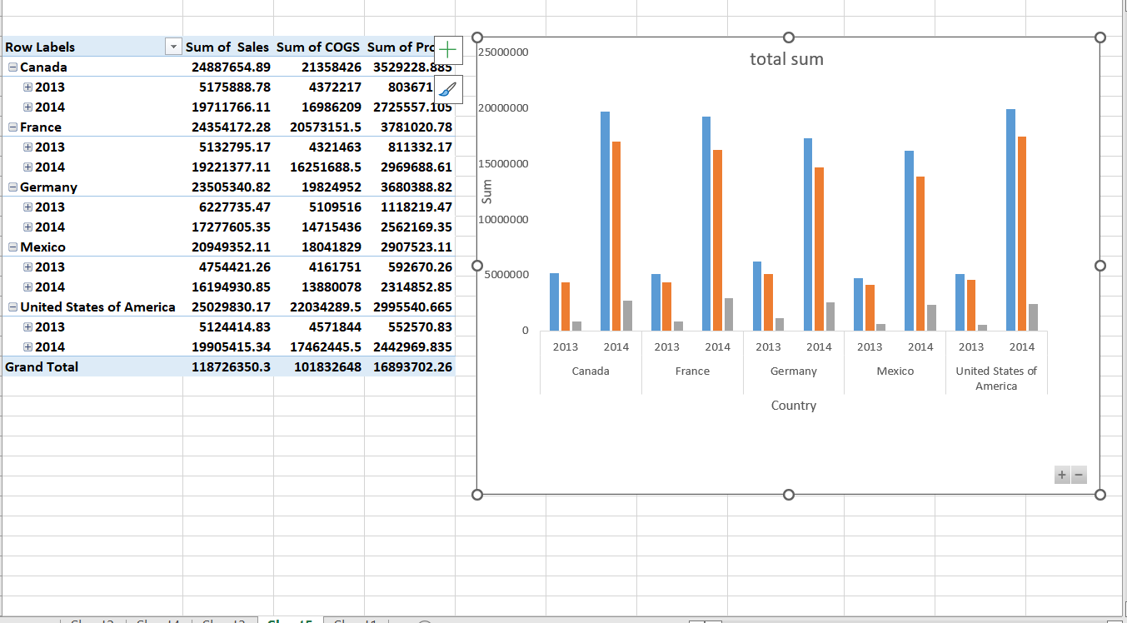
CREATED DASHBOARD IN MS EXCEL AND DRAWN FEW INSIGHTS FROM IT

Slide 3
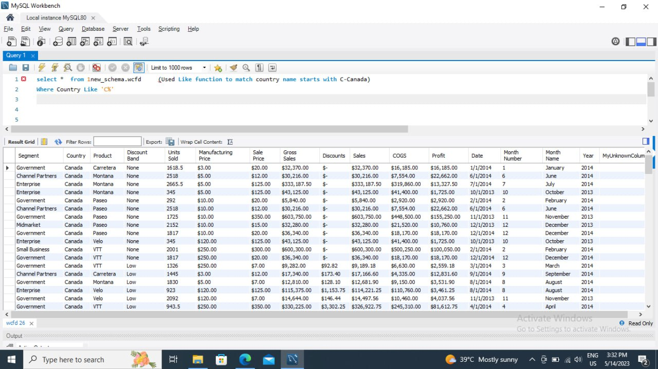
EXPORTED THE DATA IN SQL FROM MS EXCEL FILE

Slide 4
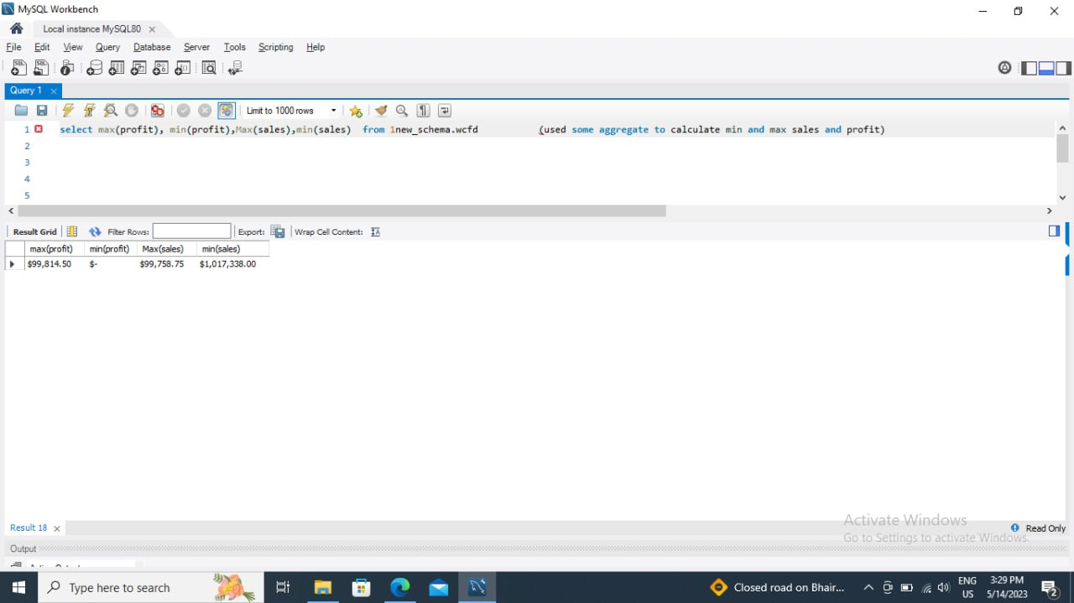
DATA IMPORTED FROM SQL AND RUNING QUERY

Slide 5
Performed Data cleaning and other possible operations on data using query editor

Slide 6
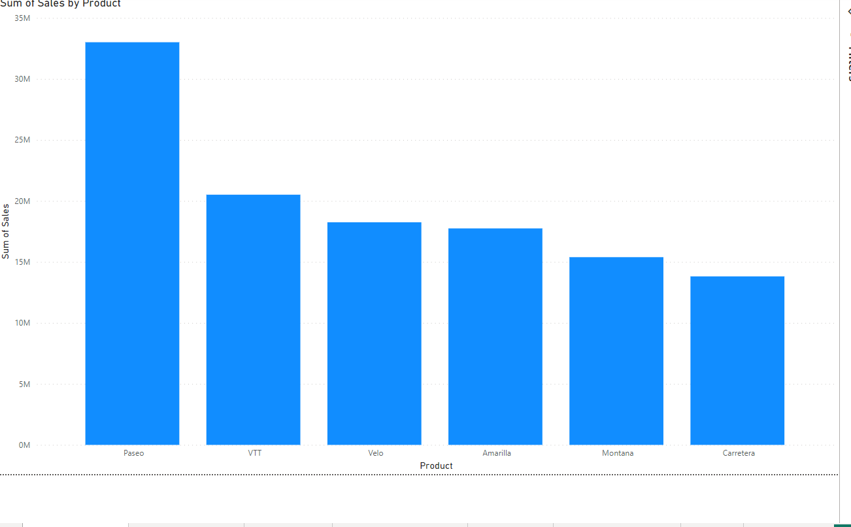
PRODUCT BY SALES

Slide 7
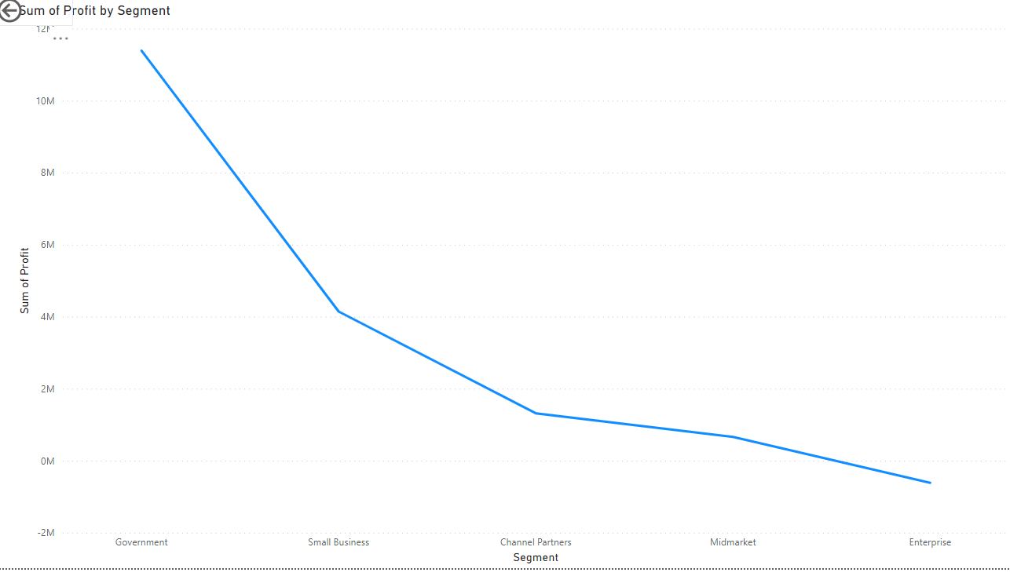
SEGMENT WISE PROFIT

Slide 8
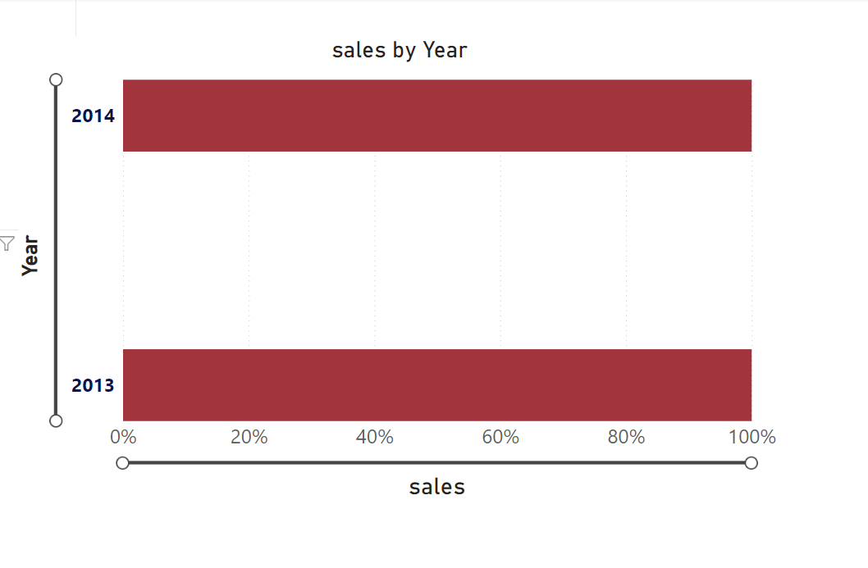
SALES BY YEAR

Slide 9
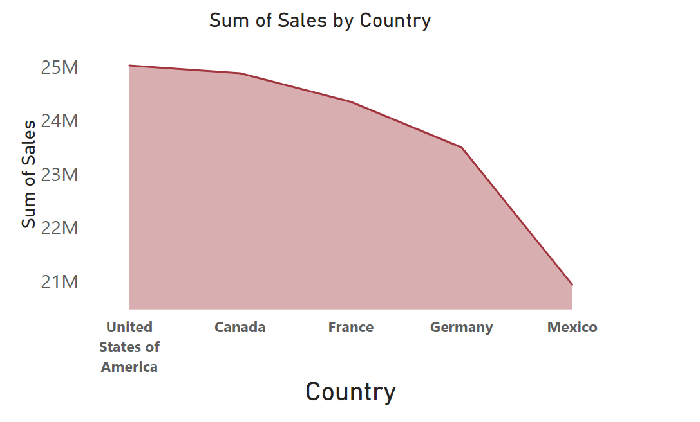

Slide 10
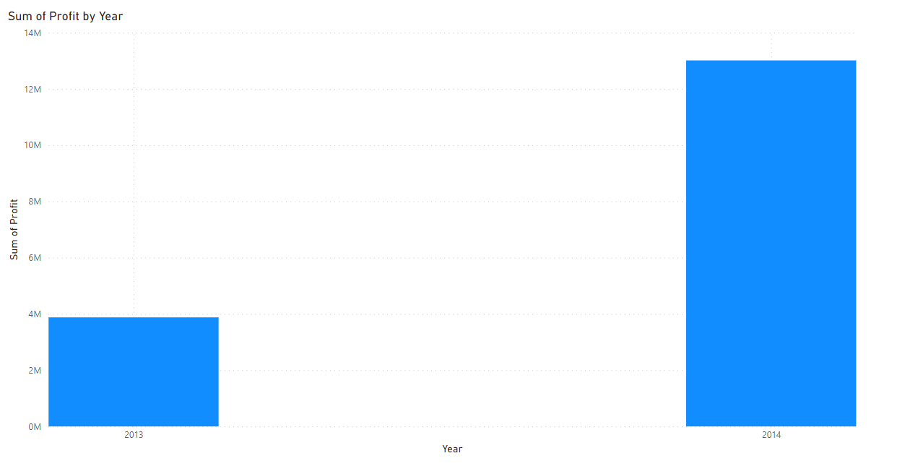
YEARLY PROFIT

Slide 11
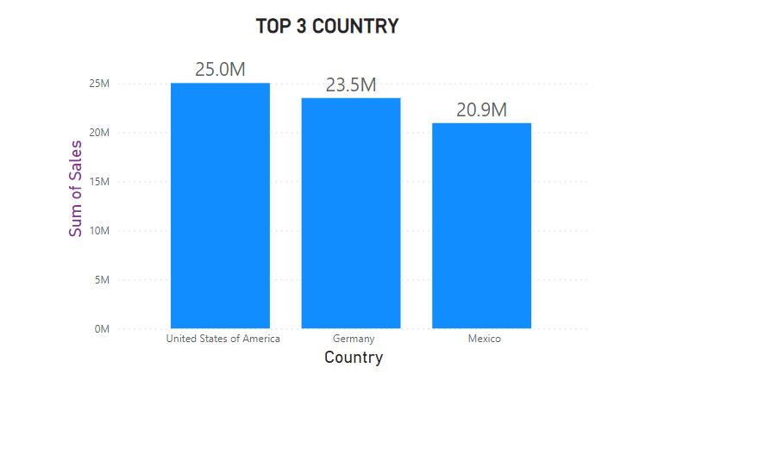

Slide 12
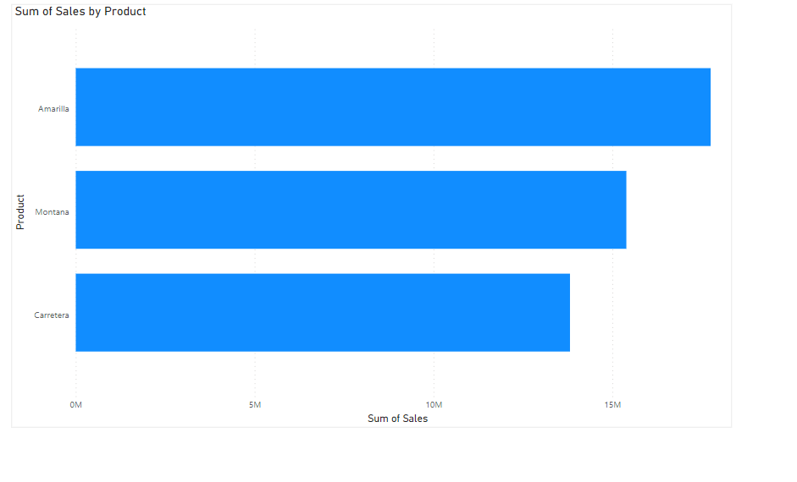
BOTTOM 3 PRODUCT

Slide 13
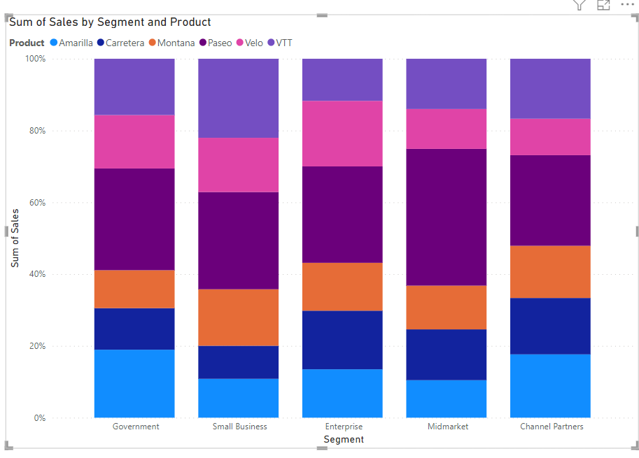
Segment wise Product Sales

Slide 14
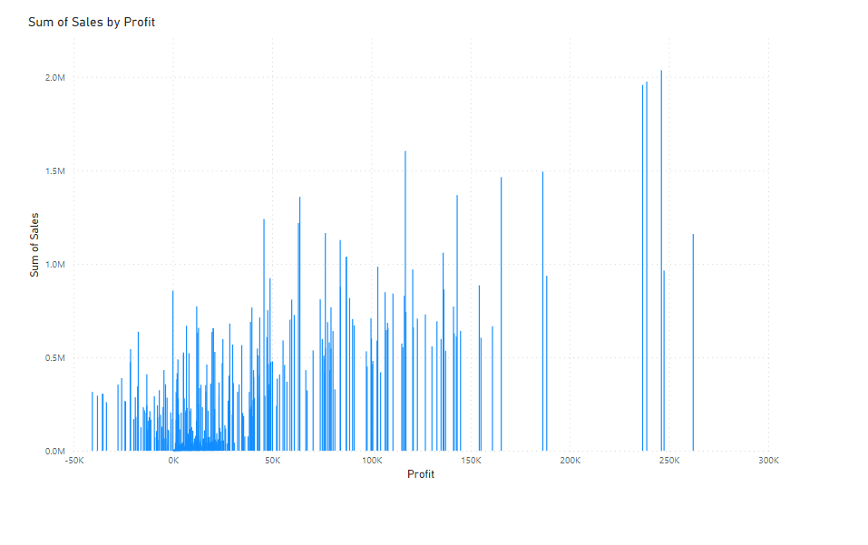
Profit and sales by Qtr

Slide 15
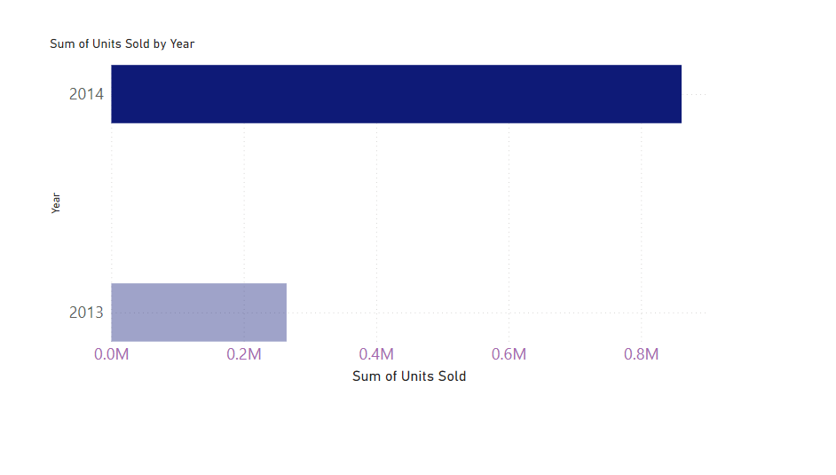
No. of units sold year over year

Slide 16
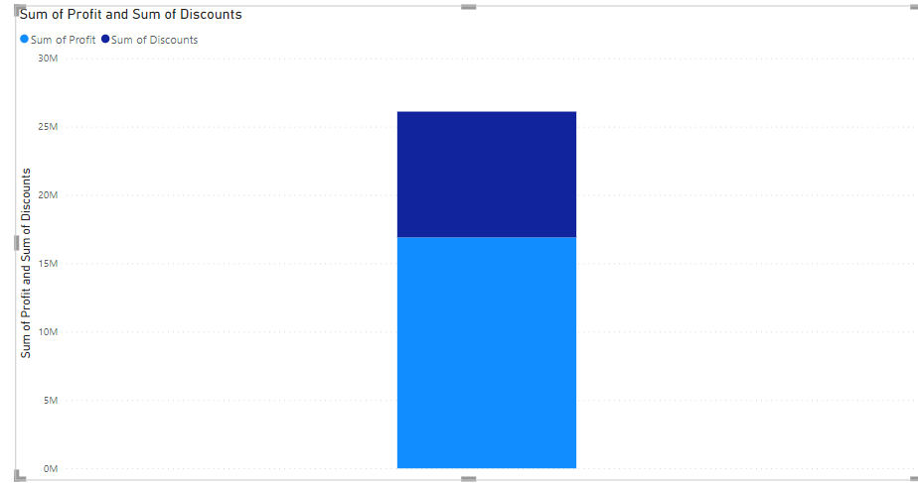
Product wise discount

Slide 17
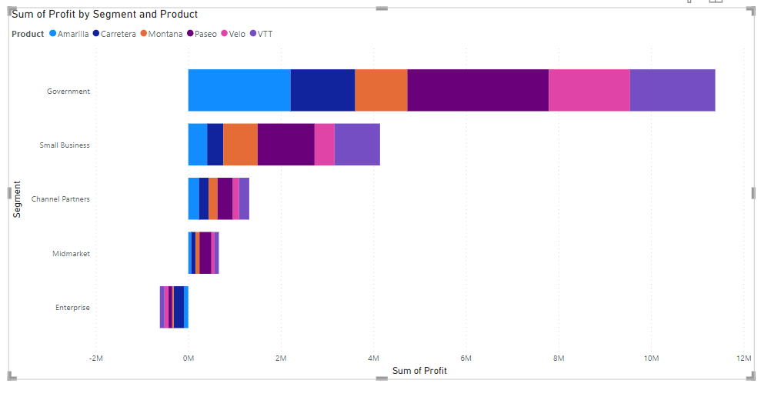
Segment wise product wise profit

Slide 18
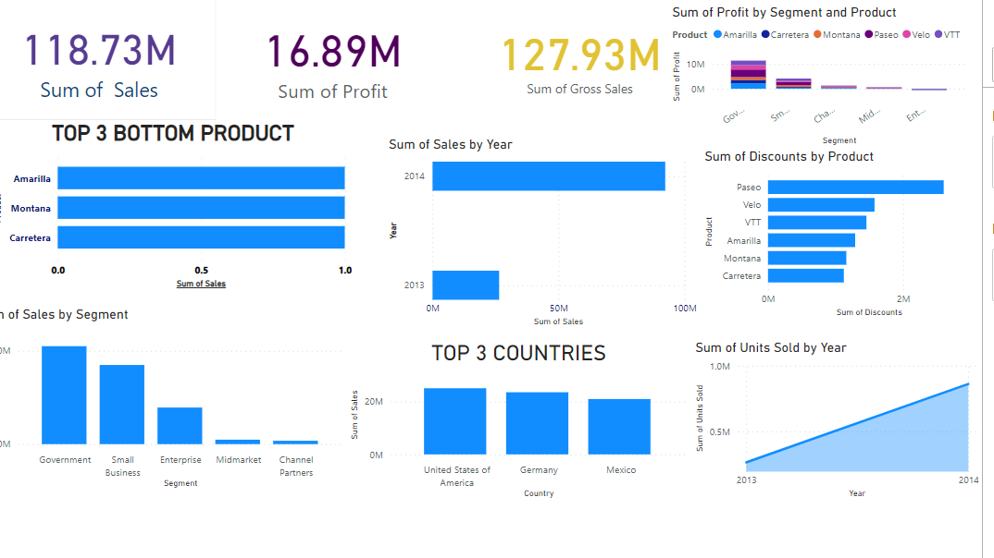
DASHBOARD

